Slide 1


West Goshen Township
Brandywine and Goose Creek TMDL Plans - Deconstructed
October 5, 2015

Slide 2
Herbert, Rowland & Grubic, Inc.
Headquartered in Harrisburg, PA
180 employees
Municipal services for +50 years
Adrienne Vicari, P.E. , Regional Financial Service Group Manager
  avicari@hrg-inc.com
Erin Letavic, M.Eng., EIT, Project Manager
  mbonanno@hrg-inc.com

Slide 3
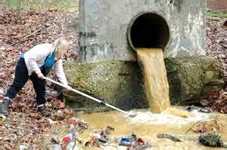
MS4 Permit
NPDES (National Pollutant Discharge Elimination System) General Permit (PAG-13) or Individual Permit (IP) for Stormwater Discharges from Small Municipal Separate Storm Sewer Systems (MS4s)
  WATER QUALITY PERMIT
  Stormwater runoff carries pollutants

Slide 4
MS4
(Municipal Separate Storm Sewer System)
Pipes
Inlets
Swales
Detention BMPs
Infiltration BMPs
Water Quality BMPs
  The SYSTEM that collects, conveys, or manages stormwater

Slide 5

Two Problems
Economic Progress (land development)
  Problem #1: Increase in quantity
  Problem #2: Decrease in quality
Aging Infrastructure
  Problem #1: Funding challenges
  Problem #2: What design standards?
Notes:
Design – design storm, climate change, affordable, include WQ, updated ordinances

Slide 6
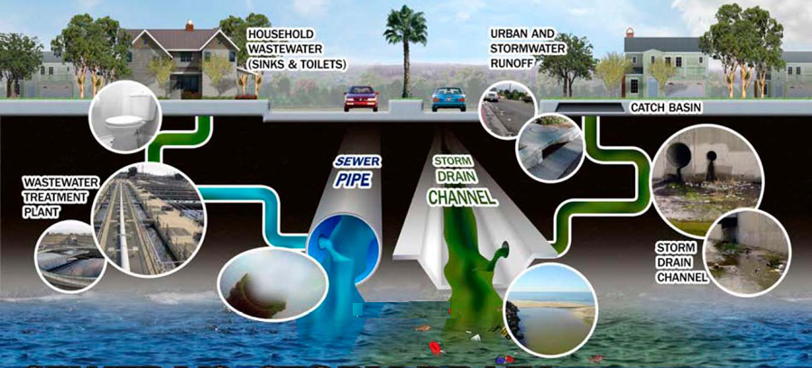
Notes:
Public doesn’t necessarily understand that stormwater runoff is discharged untreated at its endpoint

Slide 7
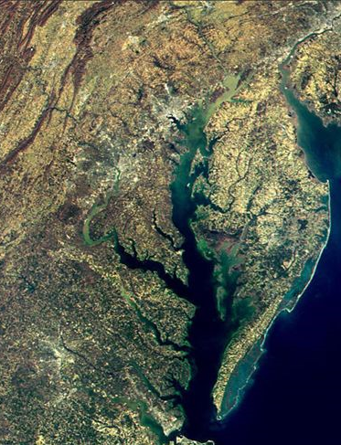
Stormwater Pollutants
Sediment
Nutrients (nitrogen & phosphorus)
Bacteria
Oxygen Demand
Oil and Grease
Metals
Toxic Chemicals
Chlorides
Thermal Impacts
Pesticides & Herbicides
Chesapeake Bay TMDL
(Total Maximum Daily Load)

Slide 8
Stormwater Pollutants
Brandywine Creek/
Christina River TMDL
(Total Maximum Daily Load)
Pollutant: Sediment
Required Reduction: 61%
Restore recreation and protection of aquatic life
Goose Creek TMDL
(Total Maximum Daily Load)
Pollutant: Phosphorus
Required Reduction: 54%
Protection of aquatic life

Slide 9
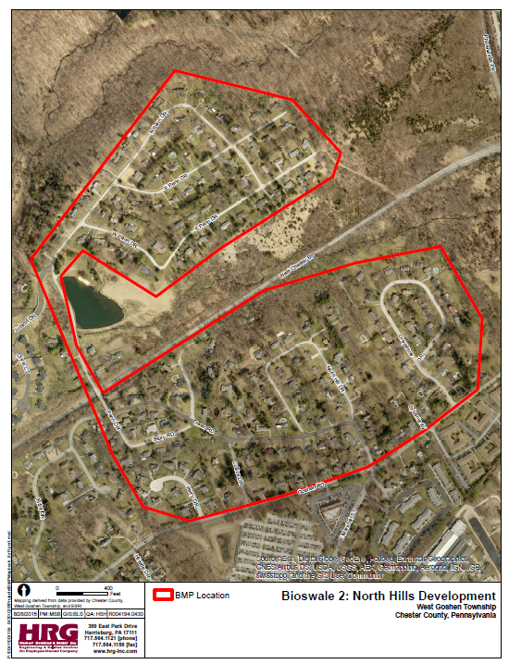
TMDL Plan Development
Township staff outreach
GIS mapping
Modeling
  MapSheds
Cost Estimates
Implementation Schedule

Slide 10
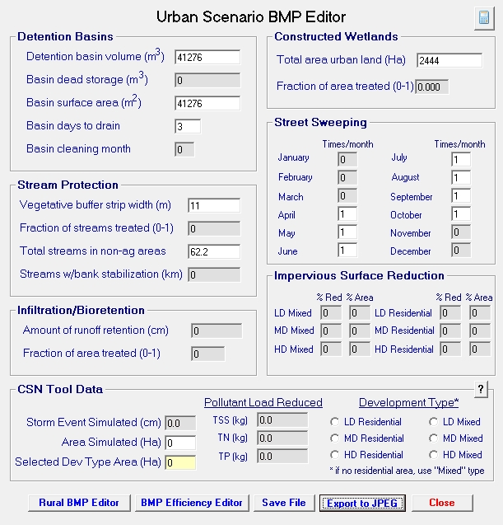
TMDL Plan Development
Modeling
  MapSheds
  Pollutant loading assumptions according to land use
  BMP benefits
    Detention basin naturalization
    Bioswales
    Stream buffers
    Street sweeping

Slide 11
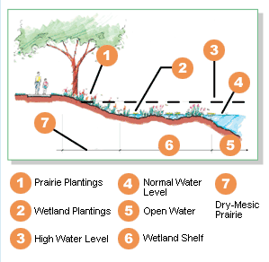
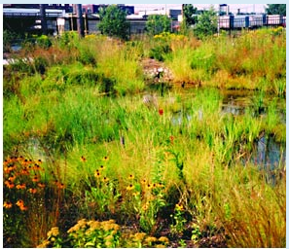
TMDL Plan Development
Detention basin naturalization
Bioswale
Stream buffer
Streetsweeping

Slide 12
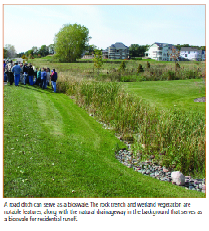
TMDL Plan Development
Detention basin naturalization
Bioswale
Stream buffer
Streetsweeping

Slide 13
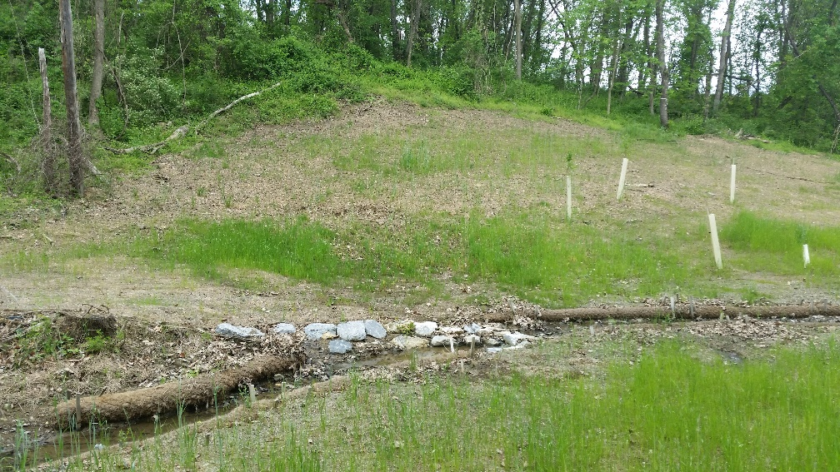
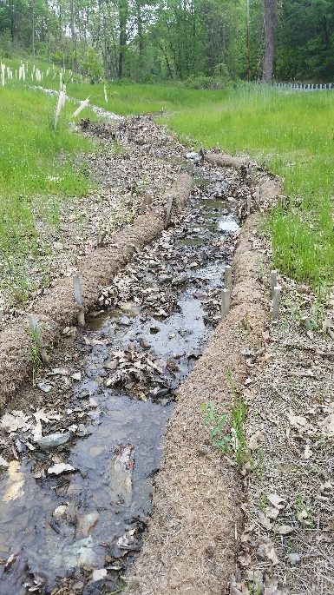
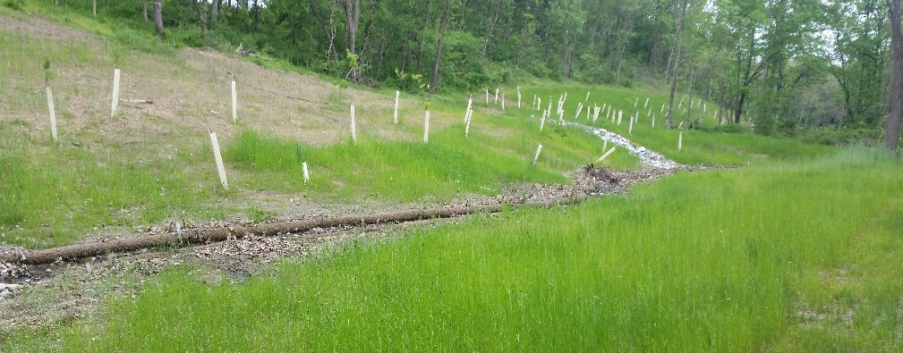
TMDL Plan Development
Detention basin naturalization
Bioswale
Stream buffer
Streetsweeping

Slide 14
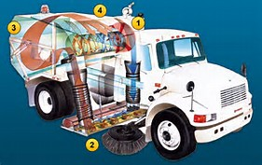
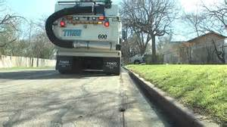
TMDL Plan Development
Detention basin naturalization
Bioswale
Stream buffer
Streetsweeping

Slide 15
TMDL Plan Development
Cost Estimates
  Detention basin naturalization
  Bioswales
  Stream buffers
  Street sweeping

Slide 16
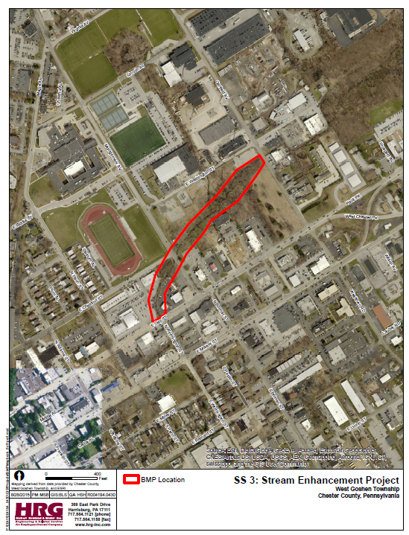
TMDL Plan Development
Implementation Schedule
  Goose Creek
    Three permit terms (15 years, 2027)
    $1.1 million
  Brandywine Creek
    Four permit terms (20 years, 2032)
    $2.1 million
  Streetsweeping (township wide)
    $255k initial purchase
    $375k annual

Slide 17
What do these costs mean to the community?
Results in an annual stormwater program cost of approx. $1.2M
  (Assumes ex. Stormwater O&M crew is funded through Township General Fund)
Rough estimate of associated Clean Water Management Fee for Avg. Single Family Property
= $6.50 per month +/-
(Fee may change based upon policy and funding decisions made by the Authority or Township in addition to DEP’s approved implementation schedule.)

Slide 18
What is the Range of SWU Fees Charged Nationwide?
Fees range from $0 to $35 per month
Ref: WKU Stormwater Utility Survey 2014

Slide 19

OUTLINE OF KEY RESPONSIBILITIES FOR
WEST GOSHEN’S STORMWATER PROGRAM
West Goshen Township Stormwater Authority
Stakeholder Advisory Committee (SAC)
West Goshen Township
Provide a partnership between the Township and residents/businesses/industries/ institutions for effective storm-water management
Provide technical and value-based input on stormwater issues
Collaborate and network together on stormwater-related topics that affect the community
Serve as a sounding board to the Township and Authority on the Stormwater Program
Serve as liaisons within areas of influence for the Township/ Authority’s stormwater program
Engage and educate the public on the Township/Authority’s Stormwater Management Program
Appoint Authority & SAC Members
Handle day-to-day operation and maintenance activities of the system
Serve as MS4 Permittee
Complete Permit/regulatory compliance activities
Complete engineering and management of projects
Complete private infrastructure inspection and enforcement activities
Enhance and maintain GIS and Asset Management systems
Complete customer billing functions
Enact Clean Water Management fee and associated charges
Adopt annual budgets which account for revenue and expenditures necessary to operate, maintain, and improve stormwater facilities
Outline strategy and recommendations to Township for comprehensive O&M
Complete comprehensive condition assessment and priority planning
Provide recommendations to the Township on the financing of capital improvements
Obtain funding as needed

Slide 20

Next Steps
Public comment period closes October 23, 2015
Revise report November 2015
Submit report December 2015
Implementation?
Funding?

