Slide 1

Township Supervisors
Robin Stuntebeck, Chair
Hugh J. Purnell, Jr., Vice-Chair
Christopher Pielli, Esq., Member
Edward G. Meakim, Jr., Member
Shaun Walsh, Member
Township Staff
Casey LaLonde, Township Manager
Derek Davis, Assistant Township Manager
Rick Craig, P.E., CSM, Township Engineer
STORMWATER MANAGEMENT
Notes:
The Township is governed by five Supervisors, elected at large for staggered six year terms.
The Township intends to pass the an ordinance and Articles of Incorporation at their March 11th meeting establishing the Stormwater Authority. The Authority will be comprised of 5 members and we’ll be introducing those members to you at the 2nd or 3rd SAC meeting.

Slide 2

What is Stormwater?
Stormwater is water runoff after a rain storm from streets, construction sites, parking lots, buildings and other areas that goes directly into storm drains and eventually into local streams and rivers.
Any water runoff can transport pollutants into streams (not necessarily from precipitation)
  - Wash vehicles
  - Snow melt
  - Drainage

Slide 3
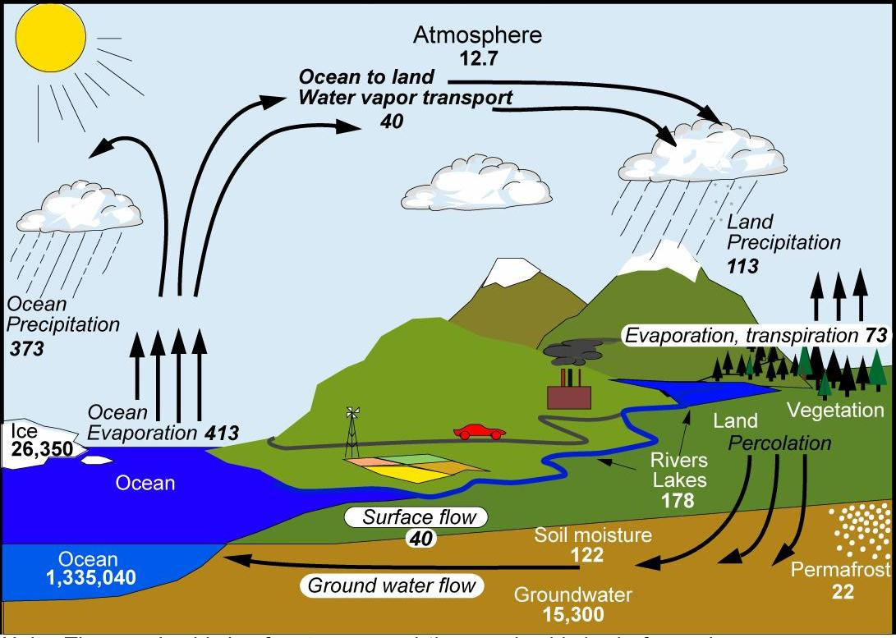
Hydrologic Cycle

Slide 4

History of Stormwater Management
No. 1 – Run It into Ditches…
To Stream

Slide 5
History of Stormwater Management
No. 2 – Run It into Combined Sewer Pipes…
To Stream

Slide 6
History of Stormwater Management
No. 3 – Run It into Separate Stormwater Pipes…
To Treatment Plant
To Stream

Slide 7
History of Stormwater Management
No. 4 – Keep it from Pipes…
To Stream
BASIN

Slide 8

History of Stormwater Management
No. 5 – Reduce Pollutants/Implement BMPs/Permit Compliance
To Stream
BASIN
  Green Infrastructure
  TMDLs
  Regulatory Permits

Slide 9
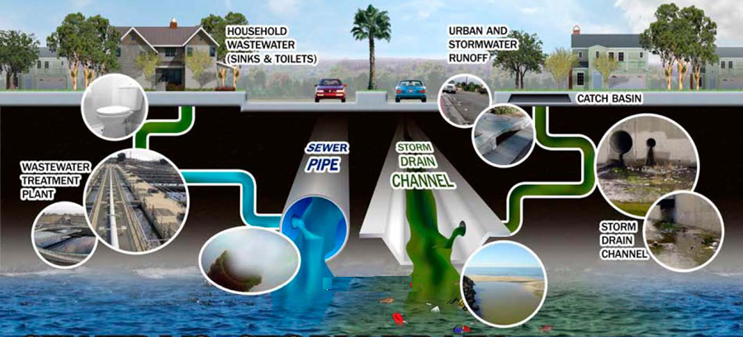
Notes:
Public doesn’t necessarily understand that stormwater runoff is discharged untreated at its endpoint

Slide 10
Common Stormwater Problems

Slide 11
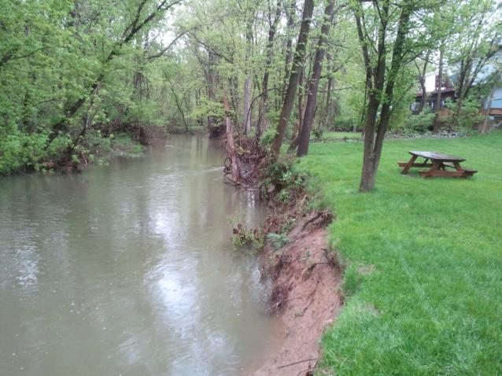
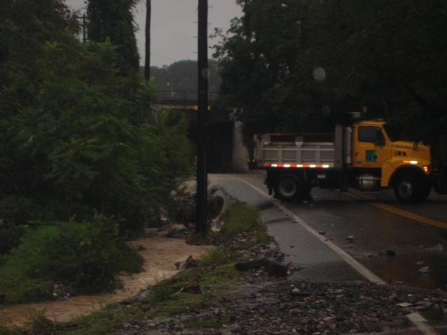
Stream Bank Stability

Slide 12
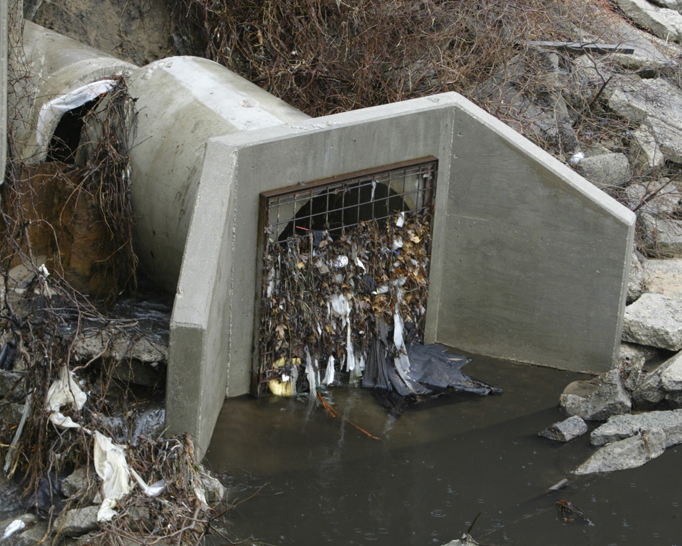
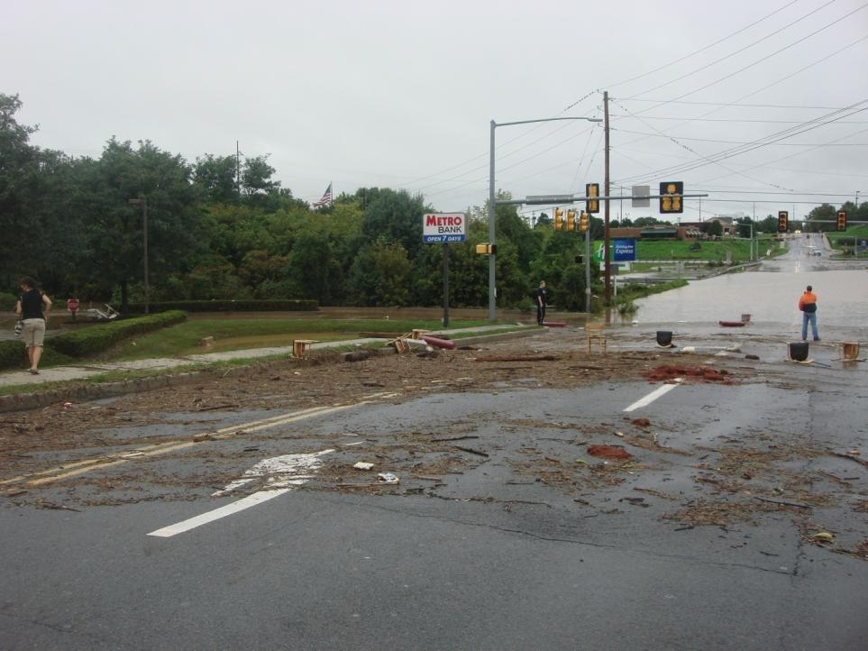
Debris/Pollution

Slide 13
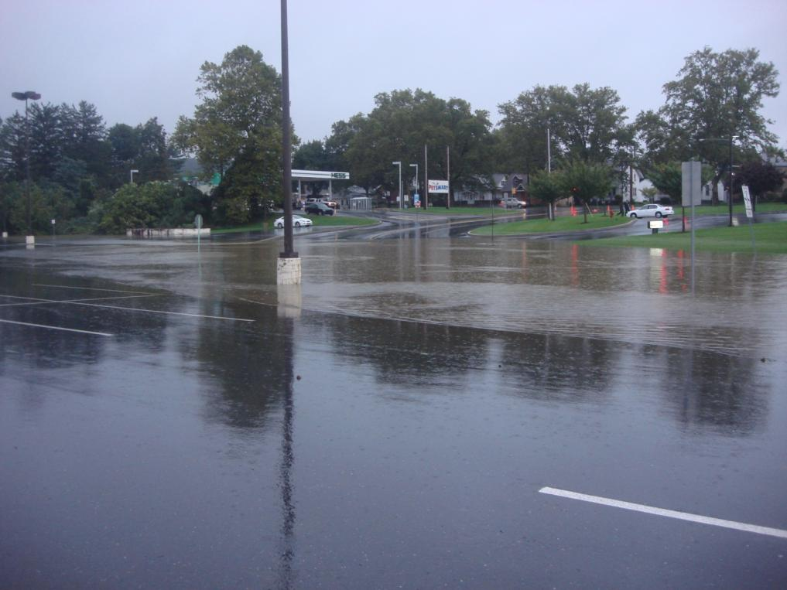
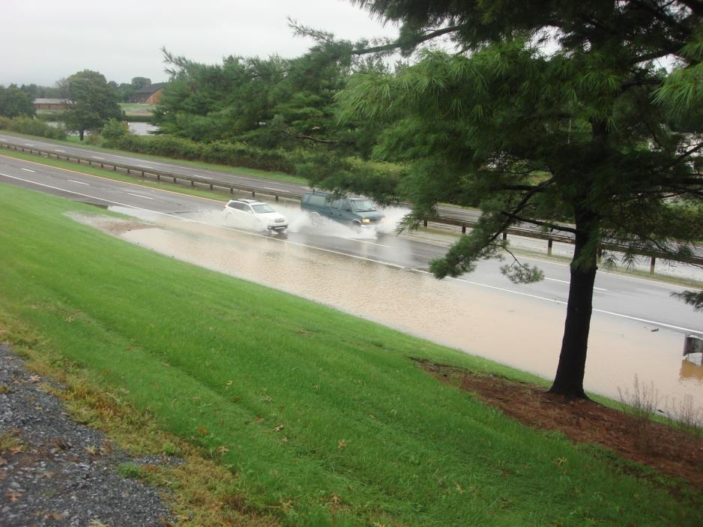
Road Closures & Traffic Incidents

Slide 14
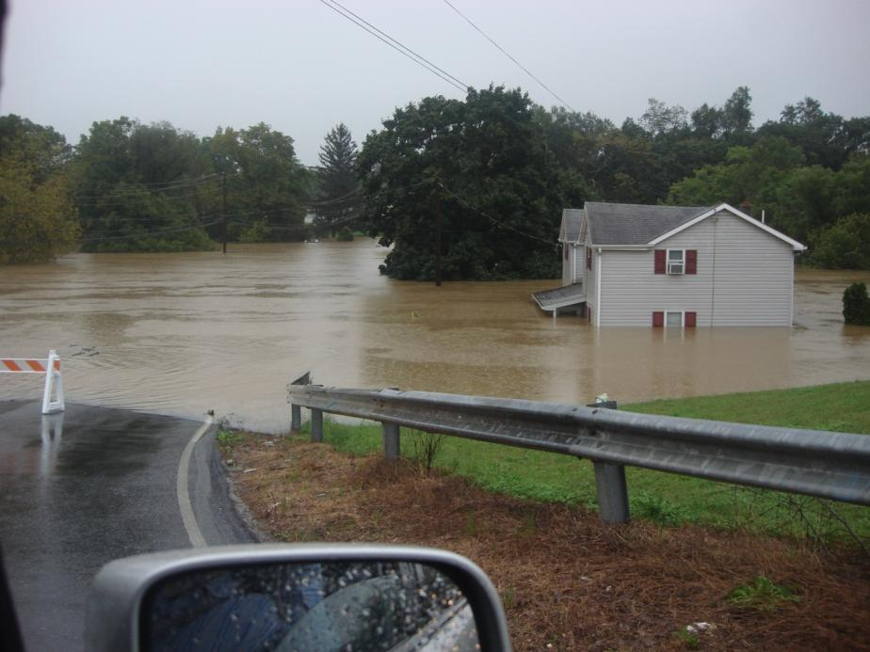
Property Flooding

Slide 15
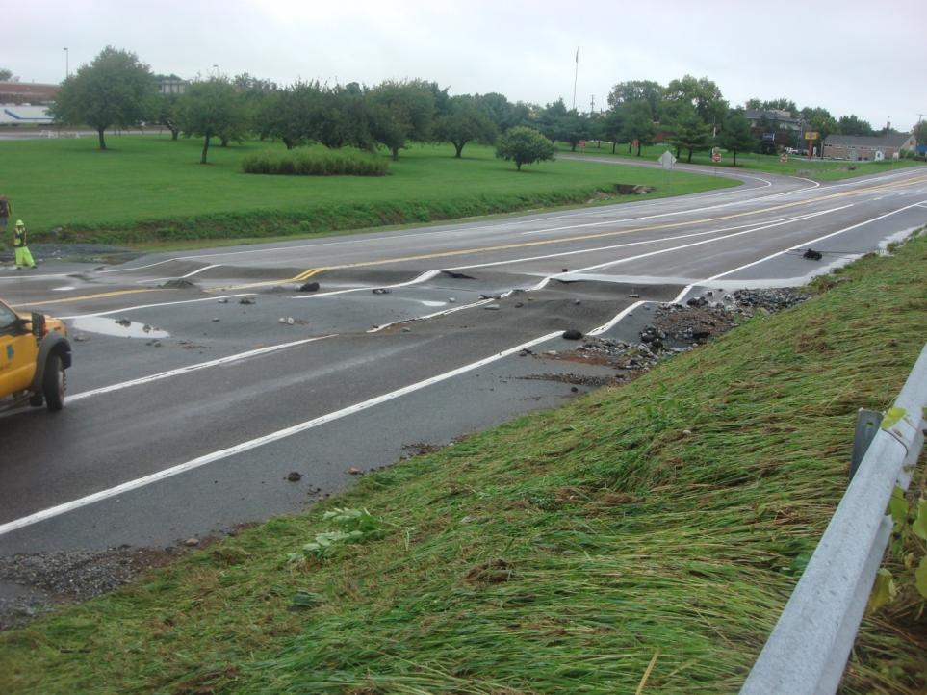
Pretty Powerful?

Slide 16
Best Management Practices (BMPs)

Slide 17
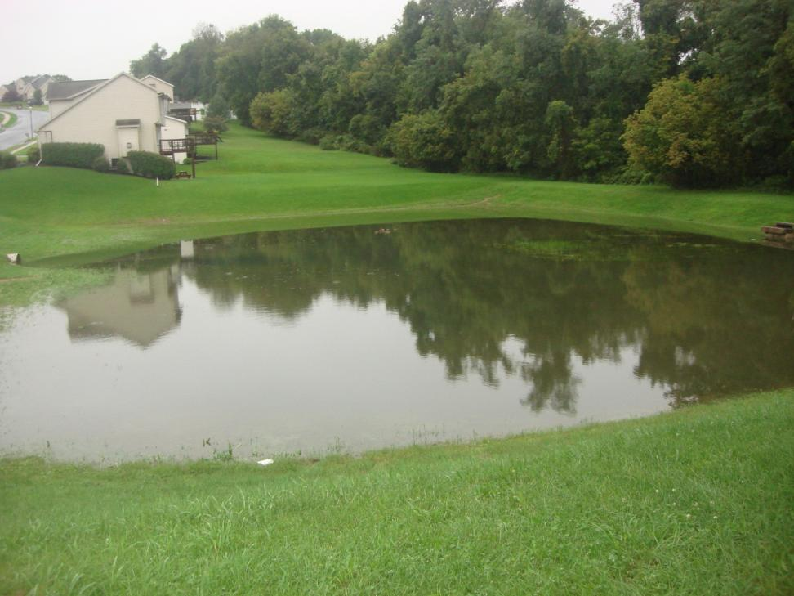
Functional Detention Basins

Slide 18
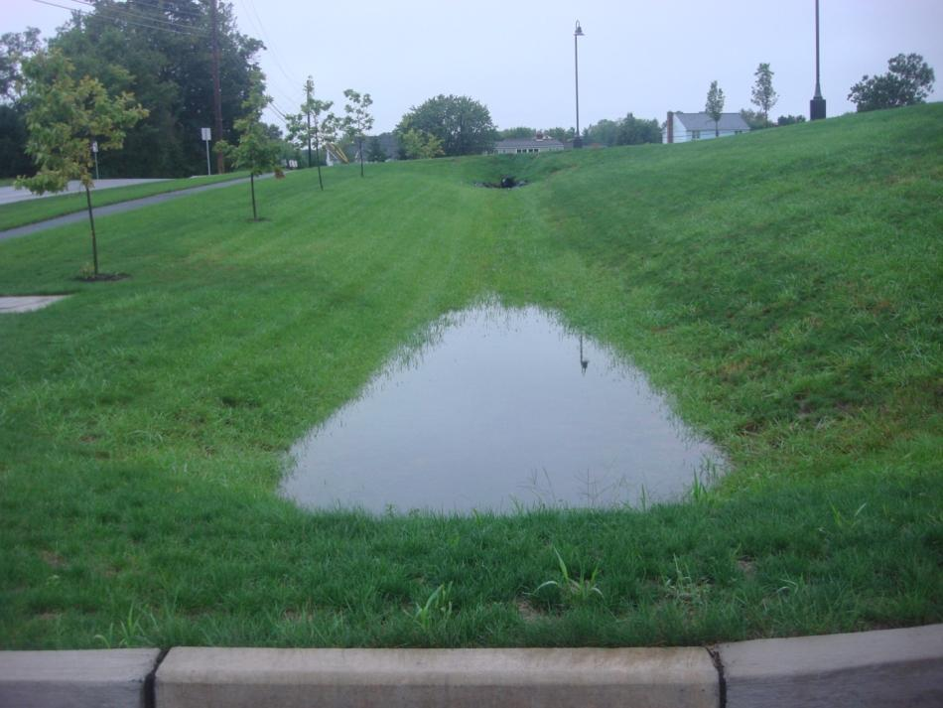
Vegetated Swales

Slide 19
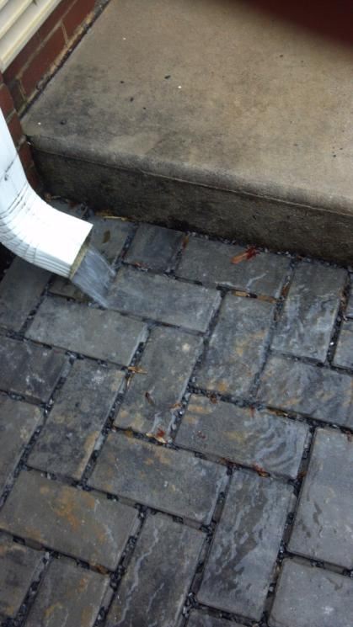
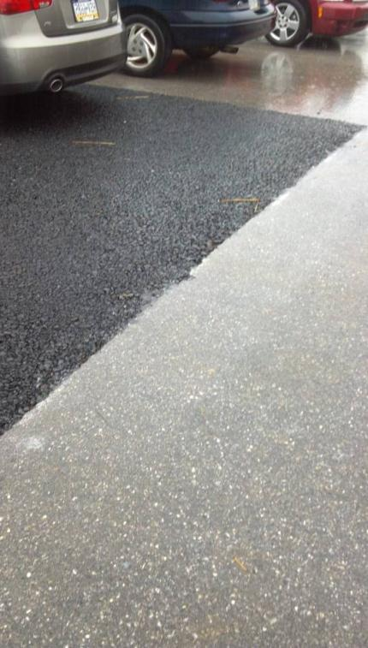
Block Pavers
Porous Asphalt

Slide 20
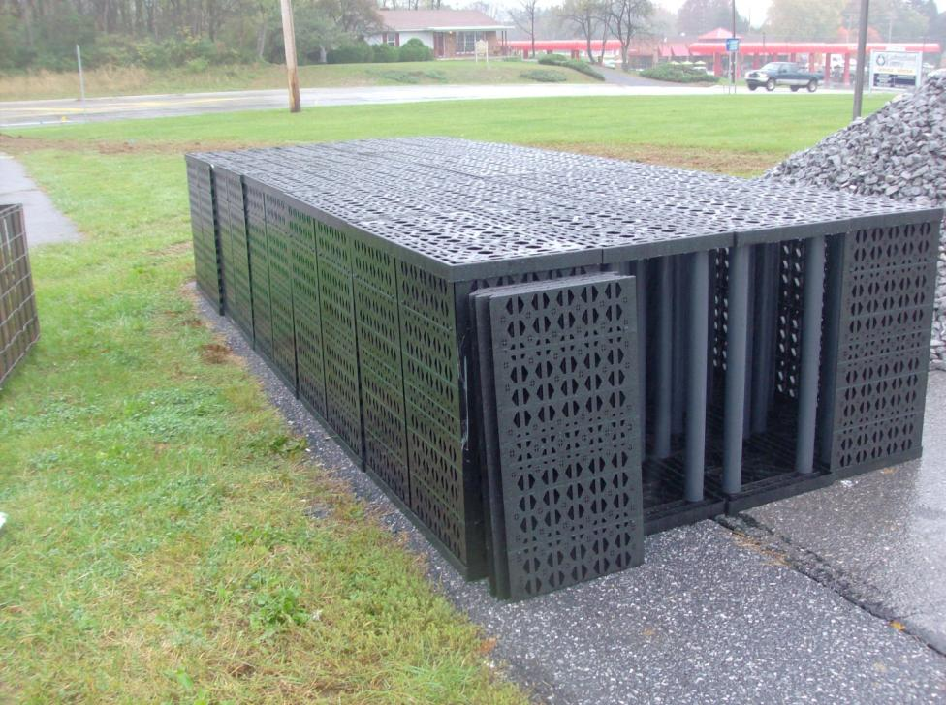
Storm Tanks

Slide 21
New Challenges and Mandates

Slide 22
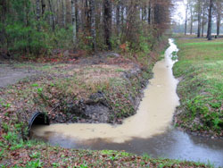
Erosion Control

Slide 23
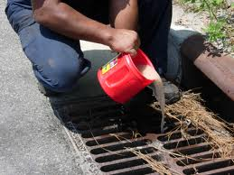
Paint/Oil in Drain

Slide 24

Oil Sheen

Slide 25

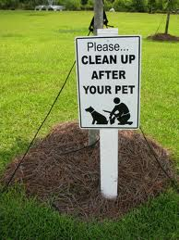
Fertilizers/ Pet Waste

Slide 26
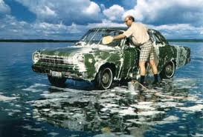
Car Wash

Slide 27
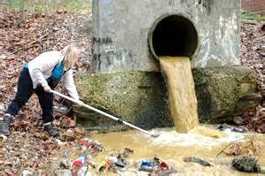
MS4 Permit
NPDES (National Pollutant Discharge Elimination System) General Permit (PAG-13) or Individual Permit (IP) for Stormwater Discharges from Small Municipal Separate Storm Sewer Systems (MS4s)
  WATER QUALITY PERMIT
  Stormwater runoff carries pollutants

Slide 28
MS4
(Municipal Separate Storm Sewer System)
Pipes
Inlets
Swales
Detention BMPs
Infiltration BMPs
Water Quality BMPs
  The SYSTEM that collects, conveys, or manages stormwater

Slide 29

Two Problems
Economic Progress (land development)
  Problem #1: Increase in quantity
  Problem #2: Decrease in quality
Aging Infrastructure
  Problem #1: Funding challenges
  Problem #2: What design standards?
Notes:
Design – design storm, climate change, affordable, include WQ, updated ordinances

Slide 30
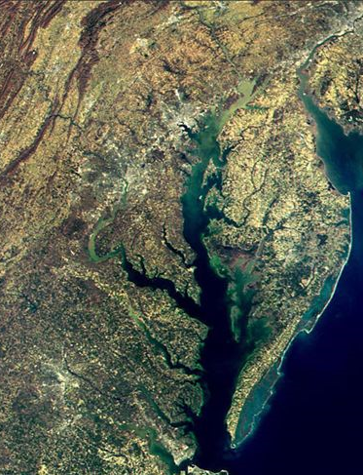
Stormwater Pollutants
Sediment
Nutrients (nitrogen & phosphorus)
Bacteria
Oxygen Demand
Oil and Grease
Metals
Toxic Chemicals
Chlorides
Thermal Impacts
Pesticides & Herbicides
Chesapeake Bay TMDL
(Total Maximum Daily Load)

Slide 31
Stormwater Pollutants
Brandywine Creek/
Christina River TMDL
(Total Maximum Daily Load)
Pollutant: Sediment
Required Reduction: 61%
Restore recreation and protection of aquatic life
Goose Creek TMDL
(Total Maximum Daily Load)
Pollutant: Phosphorus
Required Reduction: 54%
Protection of aquatic life

Slide 32
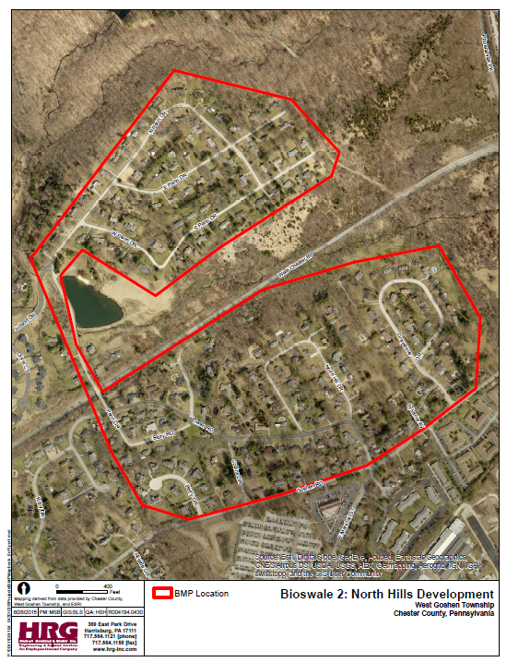
TMDL Plan Development
Township staff outreach
GIS mapping
Modeling
  MapSheds
Cost Estimates
Implementation Schedule

Slide 33
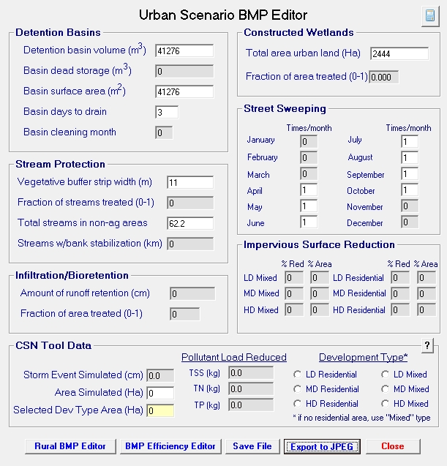
TMDL Plan Development
Modeling
  MapSheds
  Pollutant loading assumptions according to land use
  BMP benefits
    Detention basin naturalization
    Bioswales
    Stream buffers
    Street sweeping

Slide 34
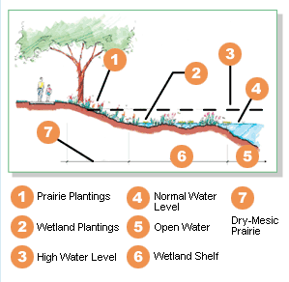
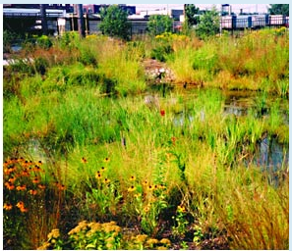
TMDL Plan Development
Detention basin naturalization
Bioswale
Stream buffer
Streetsweeping

Slide 35
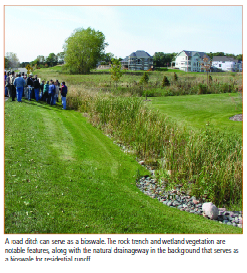
TMDL Plan Development
Detention basin naturalization
Bioswale
Stream buffer
Streetsweeping

Slide 36
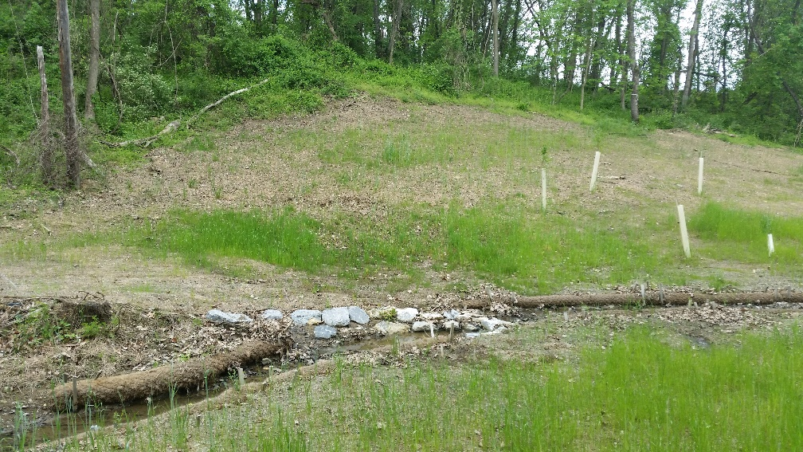
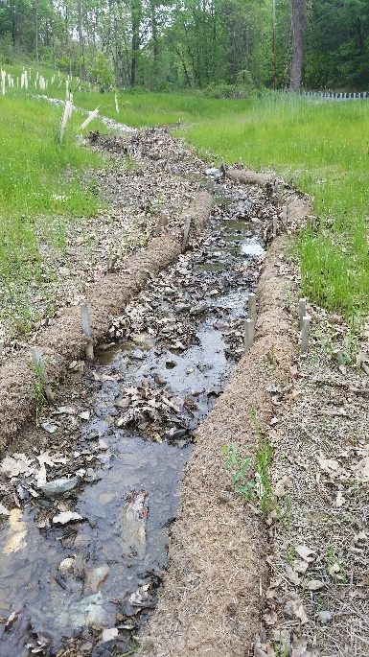
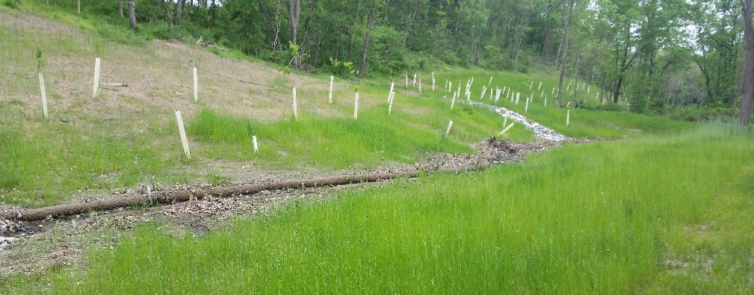
TMDL Plan Development
Detention basin naturalization
Bioswale
Stream buffer
Streetsweeping

Slide 37
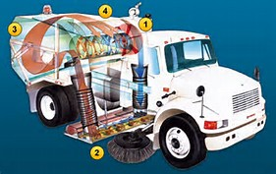
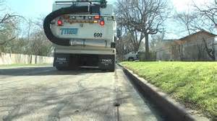
TMDL Plan Development
Detention basin naturalization
Bioswale
Stream buffer
Streetsweeping

Slide 38
TMDL Plan Development
Cost Estimates
  Detention basin naturalization
  Bioswales
  Stream buffers
  Street sweeping

Slide 39
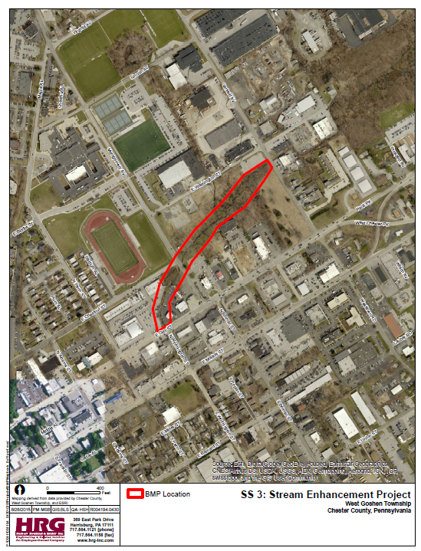
TMDL Plan Development
Implementation Schedule
  Goose Creek
    Three permit terms (15 years, 2027)
    $1.1 million
  Brandywine Creek
    Four permit terms (20 years, 2032)
    $2.1 million
  Streetsweeping (township wide)
    $255k initial purchase
    $375k annual

Slide 40
What do these costs mean to the community?
Results in an annual stormwater program cost of approx. $1.2M
  (Assumes ex. Stormwater O&M crew is funded through Township General Fund)
Rough estimate of associated Clean Water Management Fee for Avg. Single Family Property
= $6.50 per month +/-
(Fee may change based upon policy and funding decisions made by the Authority or Township in addition to DEP’s approved implementation schedule.)

Slide 41
What is the Range of SWU Fees Charged Nationwide?
Fees range from $0 to $35 per month
Ref: WKU Stormwater Utility Survey 2014

Slide 42

OUTLINE OF KEY RESPONSIBILITIES FOR
WEST GOSHEN’S STORMWATER PROGRAM
West Goshen Township Stormwater Authority
Stakeholder Advisory Committee (SAC)
West Goshen Township
Provide a partnership between the Township and residents/businesses/industries/ institutions for effective storm-water management
Provide technical and value-based input on stormwater issues
Collaborate and network together on stormwater-related topics that affect the community
Serve as a sounding board to the Township and Authority on the Stormwater Program
Serve as liaisons within areas of influence for the Township/ Authority’s stormwater program
Engage and educate the public on the Township/Authority’s Stormwater Management Program
Appoint Authority & SAC Members
Handle day-to-day operation and maintenance activities of the system
Serve as MS4 Permittee
Complete Permit/regulatory compliance activities
Complete engineering and management of projects
Complete private infrastructure inspection and enforcement activities
Enhance and maintain GIS and Asset Management systems
Complete customer billing functions
Enact Clean Water Management fee and associated charges
Adopt annual budgets which account for revenue and expenditures necessary to operate, maintain, and improve stormwater facilities
Outline strategy and recommendations to Township for comprehensive O&M
Complete comprehensive condition assessment and priority planning
Provide recommendations to the Township on the financing of capital improvements
Obtain funding as needed

Slide 43
Township Supervisors
Robin Stuntebeck, Chair
Hugh J. Purnell, Jr., Vice-Chair
Christopher Pielli, Esq., Member
Edward G. Meakim, Jr., Member
Shaun Walsh, Member
Township Staff
Casey LaLonde, Township Manager
Derek Davis, Assistant Township Manager
Rick Craig, P.E., CSM, Township Engineer
Notes:
The Township is governed by five Supervisors, elected at large for staggered six year terms.
The Township intends to pass the an ordinance and Articles of Incorporation at their March 11th meeting establishing the Stormwater Authority. The Authority will be comprised of 5 members and we’ll be introducing those members to you at the 2nd or 3rd SAC meeting.

